Slide 1
Arrays
aka. Lists
6 November 2017

Slide 2
One Variable, One Value
variable x contains 10

Slide 3
One Variable, Many Values
variable x contains 10, 11, 2, and 7

Slide 4
Our First Array
brackets tell p5 we’re making an array
commas separate each value in the array

Slide 5
How Do We Access the Values?
0 1 2 3
index
The first index is 0, not 1

Slide 6
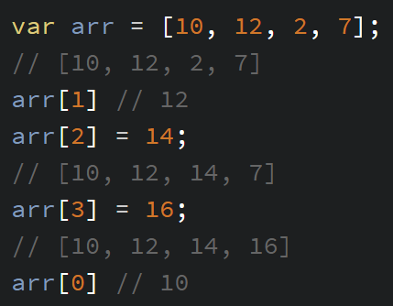
Use Each Index as an Individual Variable
READ
ASSIGN

Slide 7
Ellipse Example, pt 1
Array of Thrones

Slide 8
Indexes Have A Very Useful Pattern
0 1 2 3

Slide 9
Return of the For-Loops
0 1 2 3
for (var i = 0; i < 4; i++)
{
// i: 0, 1, 2, 3
}

Slide 10
Array Length
0 1 2 3
for (var i = 0; i < arr.length; i++)
{
// i: 0, 1, 2, 3
}
The last index will always be one less than the length

Slide 11
Ellipse Example, pt 2
A Dash of Things

Slide 12
Setting Array Values with a Loop
// Do this in setup
var arr = [];
for (var i = 0; i < 10; i++)
{
arr[i] = 7;
}
MAKE AN EMPTY ARRAY
DESIRED LENGTH
ASSIGN WITH LOOP

Slide 13
Ellipse Example, pt 3
A Swarm of Spheres
YOUR TURN: Fill array in setup, make a Fibonacci sequence of circles

Slide 14
A Quick Break
To make cold brew coffee:
Get a container
Add 1 cup of coffee for every gallon of water
2 tablespoons (1 ounce) for a pint
Put in the fridge for at least 12 hours
Filter out the grounds and enjoy!

Slide 15
Using Arrays For Colors
You can turn colors into save-able values.
var bg = color(255, 255, 100);
var colors = [
color(0, 0, 0), // black
color(255, 0, 0), // red
color(0, 0, 255), // blue
]

Slide 16
Reminder About Modulo (%)
for (var i = 0; i < 100; i++)
{
// i % 4: 0, 1, 2, 3, 0, 1, 2, 3, 0, 1, 2, 3…
fill(colors[i % colors.length])
}

Slide 17
Ellipse Example, pt 4
A Feast for Colors

Slide 18
https://cdpn.io/e/XzjWLo
Modulo colors! ☺

Slide 19
Using Arrays For Shapes
There’s no way to save a shape to a save-able value. ☹
For multiple shapes, we can save each number in a separate array.
ellipse(100, 200, 50);
var xArr = [ ];
var yArr = [ ];
var rArr = [ ];

Slide 20
https://cdpn.io/e/bYePRw
A Dance of Values

Slide 21
A Quick Break (https://cdpn.io/e/bYePRw))
30-minute Chicken Soup
Put 2 chicken thighs or breasts in a pot (can be frozen)
Cut an onion in half three ways (into eighths)
Add onions to pot and cover all ingredients with water
2 tbsp. salt, 2 tbsp. pepper
Boil for 30 minutes
Pull out and shred chicken with two forks
season with salt and pepper, add back to pot
Enjoy!
Add pasta if you want

Slide 22
More Array Methods
.unshift(value)
.push(value)
[ value, 1, 2, 3 ]
[ 1, 2, 3, value ]
[1, 2, 3]
x = .shift()
x = .pop()
[ 2, 3 ]
[ 1, 2 ]

Slide 23
The Final Upgrade
The Winds of End of Class
A Promise of Sleep

Slide 24
Homework
Sol LeWitt

Slide 25
Sol LeWitt
Wall Drawing #16 (1969)
Bands of lines 12 inches (30 cm) wide, in three directions (vertical, horizontal, diagonal right) intersecting.
Wall Drawing #17 (1969)
Four-part drawing with a different line direction in each part.
Wall Drawing #46 (1970)
Vertical lines, not straight, not touching, covering the wall evenly.

Slide 26
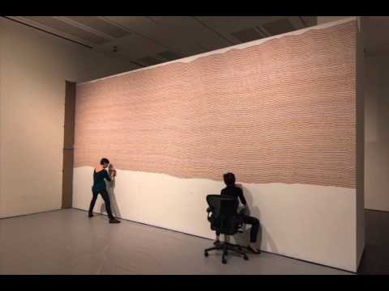
Sol LeWitt
The first drafter has a black marker and makes an irregular horizontal line near the top of the wall.
Then the second drafter tries to copy it (without touching it) using a red marker.
The third drafter does the same, using a yellow marker.
The fourth drafter does the same using a blue marker.
Then the second drafter followed by the third and fourth copies the last line drawn until the bottom of the wall is reached.

Slide 27
Minute Survey
Stick around if you have questions or if you want to play Jackbox Party Pack 3

